Slide 1
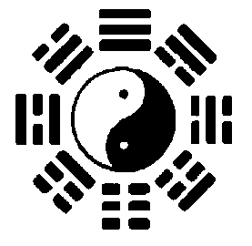
Taoism

Slide 2
It is possible that the Tao Te Ching is the most influential philosophical book in all of human history. Certainly, it is the most influential book in Chinese civilization, even while Confucianism dominated Chinese political history. No one can understand Chinese philosophy, religion, art, medicine, nor even cooking, without understanding Taoism.
Where Confucianism emphasizes one’s social and public life, Taoism emphasizes one’s individual life, and the life of your private thoughts and feelings. (Although it does have things to say about politics, economics, military policy, etc.)
Taoism also emphasizes a transcendental ‘spirit’ (as opposed to Confucian worldliness), as well as independence and non-conformity (as opposed to Confucian etiquette and propriety).

Slide 3
Some main concepts in Taoist thought:
Character and virtue (te)
Tranquility, Elegance
Spontaneity, Naturalness
Namelessness, Indescribability
Emptiness, Non-action, non-interference (wu-wei)

Slide 4
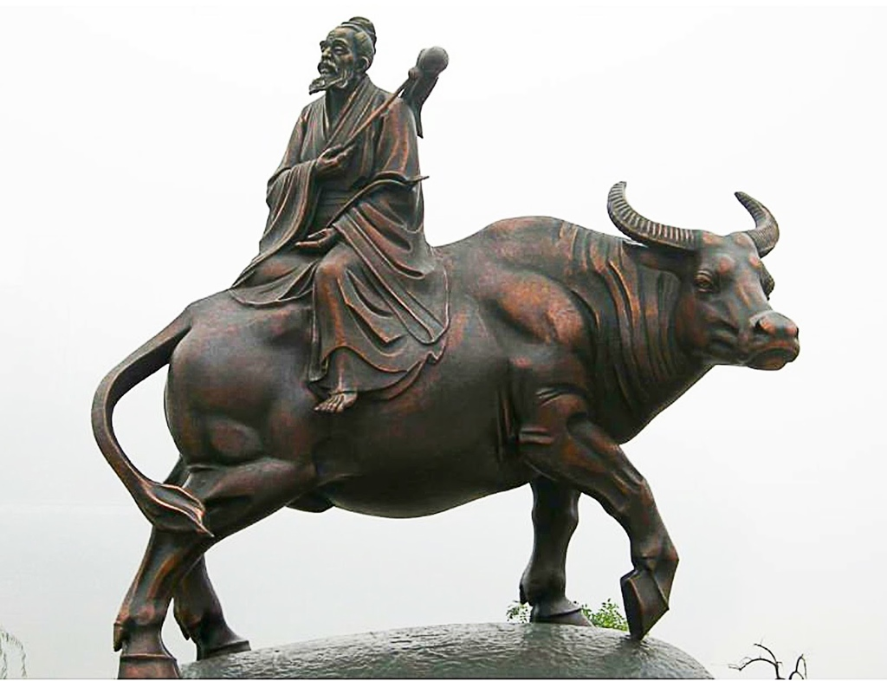
Founders:
Lao-Tzu (approx. 5th century BCE)
Chuang-Tzu (approx 4th century BCE)

Slide 5
§ 1.
The Tao that can be told is not the eternal Tao.
The name that can be named is not the eternal name.
The Nameless is the origin of Heaven and Earth.
The Named is the mother of all things.
Therefore let there always be non-being, so we may see their subtlety.
And let there always be being, so we may see their outcome.
The two are the same,
But after they are produced, they have different names.
They both may be called deep and profound.
Deeper and more profound,
The door of all subtleties!

Slide 6
§ 3.
Do not exalt the worthy, so that the people shall not compete.
Do not value rare treasures, so that the people shall not steal.
Do not display objects of desire, so that the people’s hearts shall not be disturbed.
Therefore, in the government of the sage,
He keeps their hearts vacuous,
Fills their bellies,
Weakens their ambitions,
And strengthens their bones.
He always causes his people to be without cunning or desire.
And the crafty to be afraid to act.
By acting without action, all things will be in order.

Slide 7
§ 4.
Tao is empty. Like a bowl.
It may be used but its capacity is never exhausted.
It is bottomless, perhaps the ancestor of all things.
It blunts its sharpness.
It unties its tangles.
It softens its light.
It becomes one with the dusty world.
Deep and still, it appears to exist forever.

Slide 8
§ 5.
Heaven and Earth are not humane (jen)
They regard all things as straw dogs.
The sage is not humane.
He regards all people as straw dogs.
How heaven and earth are like a bellows!
While vacuous, it is never exhausted.
When active, it produces even more.
Much talk will of course come to a dead end.
It is better to keep to the centre.

Slide 9
§ 8.
The best man is like water.
Water is good; it benefits all things and does not compete with them.
It dwells in lowly places that all disdain.
This is why it is so near to the Tao.
The best man in his dwelling loves the earth.
In his heart, he loves what is profound.
In his associations, he loves humanity.
In his words, he loves faithfulness.
In government, he loves order.
In handling affairs, he loves competence.
In his activities, he loves timeliness.
It is because he does not compete that he is without reproach.

Slide 10
§ 9.
To hold and fill to overflowing
Is not as good as to stop in time.
Sharpen a sword-edge to its very sharpest,
And the edge will not last long.
When gold and jade fill your hall,
You will not be able to keep them.
To be proud with honour and wealth
Is to cause one’s own downfall.
Withdraw as soon as your work is done.
Such is Heaven’s Way.

Slide 11
§ 13
Favour is inferior.
Be apprehensive when you receive them, and also be apprehensive when you lose them.
What does it mean to regard great trouble as seriously as you regard the body?
The reason I have great trouble is that I have a body (and am attached to it.)
If I have no body,
What trouble could I have?
Therefore he who values the world as his body may be entrusted with the empire.
He who loves the world as his body may be entrusted with the empire.

Slide 12
§ 15.
Of old, those who were the best rulers were subtly mysterious and profoundly penetrating.
Too deep to comprehend.
And because they cannot be comprehended,
I can only describe them arbitrarily.
Cautious, like crossing a frozen stream in the winter.
Being at a loss, like one fearing danger on all sides.
Reserved, like one visiting.
Supple and pliant, like ice about to melt,
Genuine, like a piece of uncarved wood.
Open and broad, like a valley.
Merged and undifferentiated, like muddy water.

Slide 13
§ 16.
All things come into being,
And I see thereby their return.
All things flourish,
But each one returns to its root.
This return to its root means tranquility.
It is called returning to destiny.
To return to destiny is called the eternal Tao.
To know the eternal is called enlightenment.
Not to know the eternal is to act blindly to result in disaster.
He who knows the eternal is all-embracing.
Being all-embracing, he is impartial.
Being impartial, he is kingly.
Being kingly, he is one with Nature.
Being one with nature, he is in accord with Tao.
Being in accord with Tao, he is everlasting.
And is free from danger throughout his lifetime.

Slide 14
§ 17.
The best rulers are those whose existence is merely known by the people.
The next best are those who are loved and praised.
The next are those who are feared.
And the next are those who are despised.
It is only when one does not have enough faith in others
That others will have no faith in him.
The great rulers value their words highly.
They accomplish their task; they complete their work.
Nevertheless the people say that they simply follow Nature.

Slide 15
§ 18
When the great Tao declined,
the doctrines of humanity and righteousness arose.
When knowledge and wisdom appeared,
There emerged great hypocrisy.
When the six family relationships are not in harmony,
There will be the advocacy of filial piety and deep love to children.
When a country is in disorder,
There will be praise for loyal ministers.

Slide 16
§ 27.
A good traveler leaves no track or trace.
A good speech leaves no flaws.
A good reckoner uses no counters.
A well shut door needs no bolts, yet it cannot be opened.
A well tied knot needs no rope and yet none can untie it.
Therefore the good man is the teacher of the bad,
And the bad is the material from which the good may learn.

Slide 17
§ 30.
He who assists the ruler with Tao does not dominate the world with force.
The use of force usually brings requital.
Wherever armies are stationed, briars and thorns grow.
Great wars are always followed by famines.
A good general achieves his purpose and stops.
But dares not seek to dominate the world.
He achieves his purpose but does not brag about it.
He achieves his purpose but does not boast about it.
He achieves his purpose but is not proud of it.
He achieves his purpose but only as an unavoidable step.
He achieves his purpose but does not aim to dominate.
For after things reach their prime, they begin to grow old.
Which means being contrary to Tao.
Whatever is contrary to Tao will soon perish.

Slide 18
§ 38.
The man of superior virtue is not conscious of his virtue,
And in this way he really possesses virtue.
The man of inferior virtue never loses sight of his virtue,
And in this way he loses his virtue.
The man of superior propriety takes action,
And when the people do not respond to it, he will stretch his arms and force it on them.
Therefore, only when the Tao is lost does the doctrine of virtue arise.
When virtue is lost, only then does the doctrine of humanity arise.
When humanity is lost, only then does the doctrine of righteousness arise.
For this reason the great man dwells in the thick [i.e. the substantial],
and does not rest with the thin [i.e. the superficial.]
He dwells in the fruit, and does not rest with the flower.

Slide 19
§53.
If I had but little knowledge,
I should, in walking on a broad way,
Fear getting off the road.
Broad ways are extremely even,
But people are fond of by-paths.
The courts are exceedingly splendid,
While the fields are exceedingly weedy,
And the granaries are exceedingly empty.
Elegant clothes are worn,
Sharp weapons are carried,
Foods and drinks are enjoyed beyond limit,
And wealth and treasures are accumulated in excess.
This is robbery and extravagance.
This is indeed not Tao.

Slide 20
§ 57.
Govern the state with correctness.
Operate the army with surprise tactics.
Administer the empire by engaging in no activity.
How do I know that this should be so?
Through this:
The more taboos and prohibitions there are in the world,
The poorer the people will be.
the more sharp weapons the people have,
The more troubled the state will be.
The more cunning and skill man possesses,
The more vicious things will appear.
The more laws and orders are made prominent,
The more thieves and robbers there will be.

Slide 21
§ 63
Act without action.
Do without ado.
Taste without tasting.
Whether it is big or small, many or few, repay hatred with virtue.
Prepare for the difficult while it is still easy.
Deal with the big while it is still small.
Difficult undertakings have always started with what is easy,
And great undertakngs have always started with what is small.
Therefore the sage never strives for the great,
And thereby the great is achieved.

Slide 22
§ 76.
When man is born, he is tender and weak.
At death, he is stiff and hard.
All things, the grass as well as trees, are tender and supple while alive.
When dead, they are withered and dried.
Therefore the stiff and the hard are companions of death.
The tender and the weak are companions of life.
Therefore if the army is strong, it will not win.
If a tree is stiff, it will break.
The strong and the great are inferior, while the tender and the weak are superior.

Slide 23
§ 77.
Heaven’s Way is indeed like the bending of a bow.
When the string is high, bring it down.
When it is low, raise it up.
When it is excessive, reduce it.
When it is insufficient, supplement it.
The Way of Heaven reduces whatever is excessive and supplements whatever is insufficient.
The way of man is different.
It reduces the insufficient to offer to the excessive.

Slide 24
§ 79
To patch up a great hatred is surely to leave some hatred behind.
How can this be regarded as good?
Therefore the sage keeps the left-hand portion [i.e. obligation] of a contract,
And does not blame the other party.
Virtuous people attend to their left-hand portions
While those without virtue attend to other people’s mistakes.
The Way of Heaven has no favourites.
It is always with the good man.

Slide 25
§ 81.
True words are not beautiful,
Beautiful words are not true.
A good man does not argue,
He who argues is not a good man.
A wise man has no extensive knowledge,
He who has extensive knowledge is not a good man.
The sage does not accumulate for himself.
The more he uses for others, the more he has himself.
The more he gives to others, the more he possesses of his own.
The Way of Heaven is to benefit others and not to injure.
The Way of the sage is to act but not to compete.

